Slide 1
EUV Lithography
齐争
11/4/2015

Slide 2
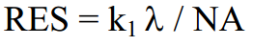
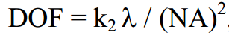
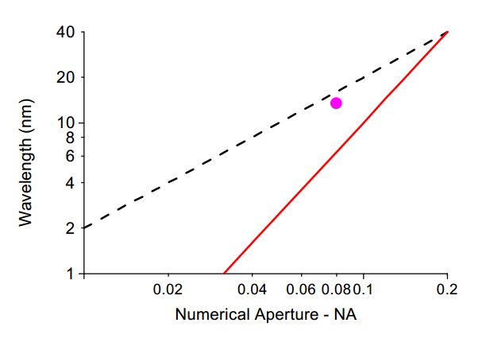
In order to keep pace with the demand for the printing of ever smaller features, lithography tool manufacturers have found it necessary to gradually reduce the wavelength of the light used for imaging and to design imaging systems with ever larger numerical apertures.
Why EUV
The region between the lines shows the wavelength and numerical aperture of cameras simultaneously having a resolution of 100 nm or better and a DOF of 0.5 um or better.
is the wavelength of the radiation used to carry out the imaging, and NA is the numerical aperture of the imaging system (or camera or optics)

Slide 3
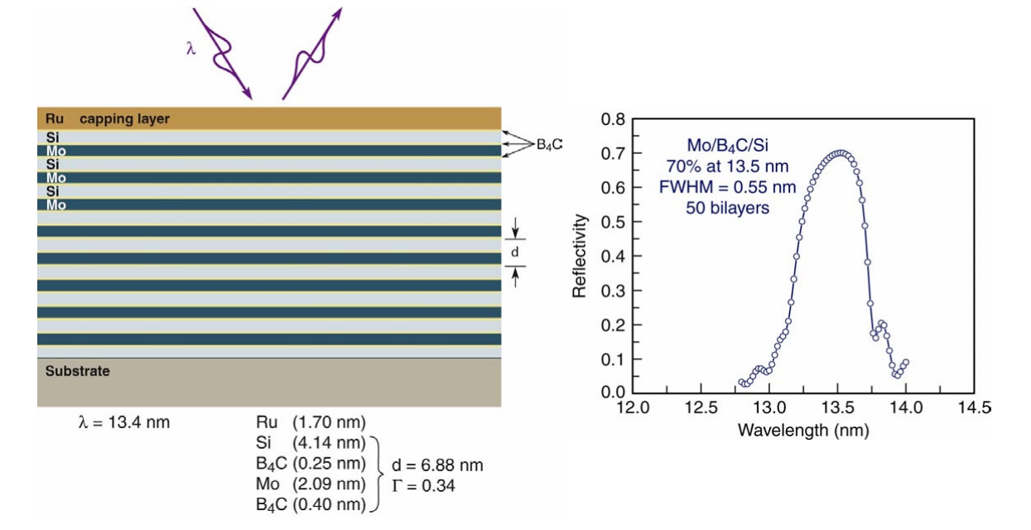
Why 13.5nm
Peak reflectivity of 70% can now be routinely attained for Mo:Si ML’s deposited by magnetron sputtering

Slide 4
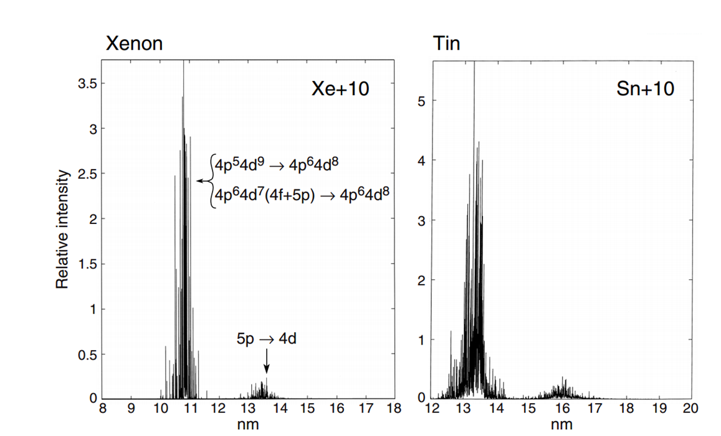
Why 13.5nm
Peak reflectivity of 70% can now be routinely attained for Mo:Si ML’s deposited by magnetron sputtering

Slide 5
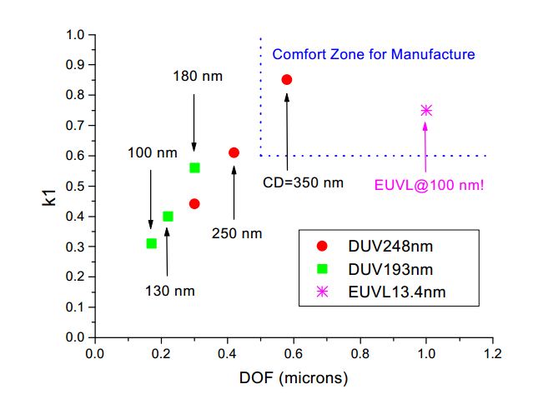
Challenges
Source
Strongly absorbed, vacuum
Reflective optical elements instead of refractive
Multilayer coating to achieve reasonable reflectivity
Mask、photoresist、scanner、process technique
The unprecedented degree of perfection in surface figure and surface finish——fabrication、metrology
…………

Slide 6
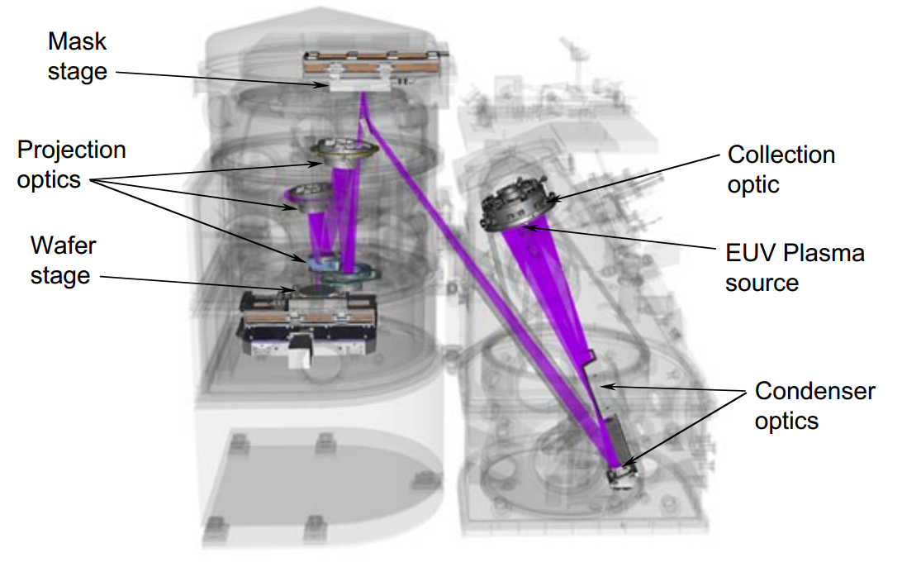
Scheme
Notes:
大概的示意图，用的激光器现在有所变化

Slide 7
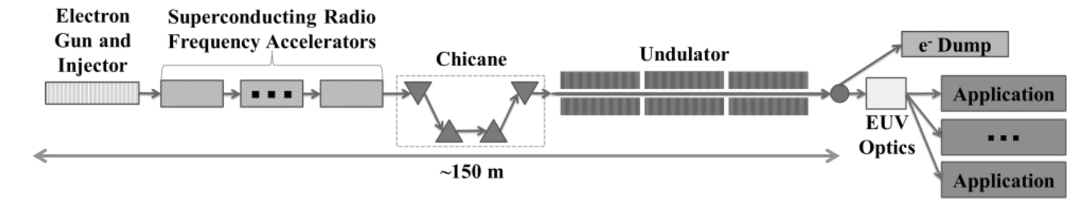
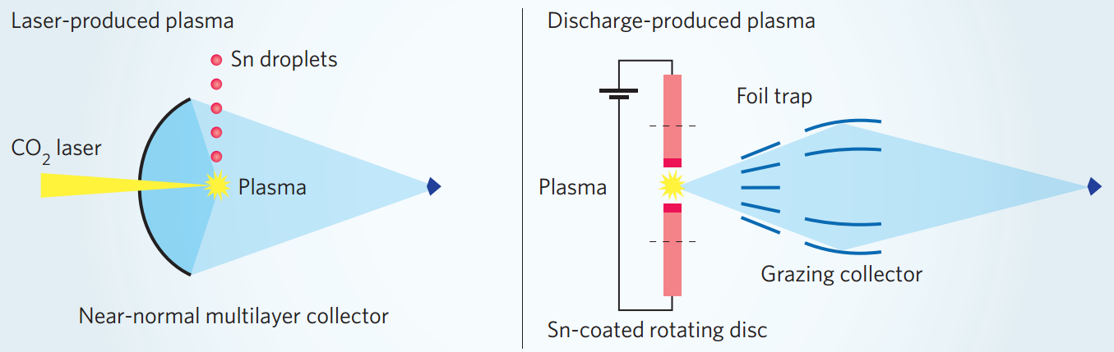
Source

Slide 8
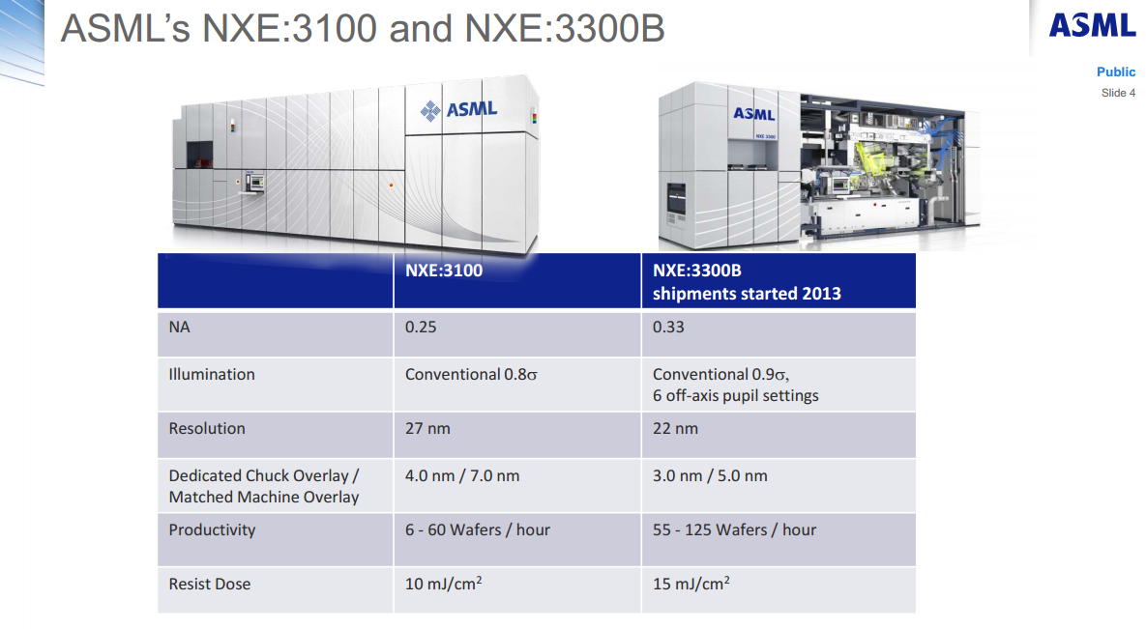
Source-LPP DPP

Slide 9
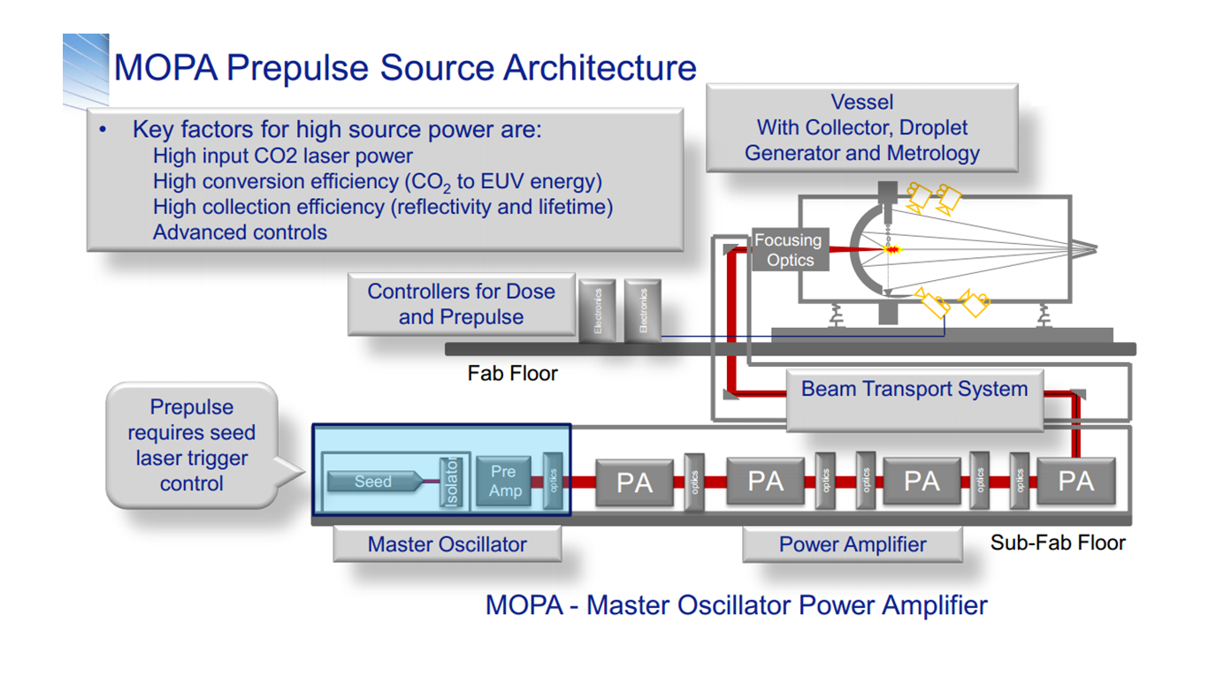
Source-LPP DPP
ASML-NXE:3300B -2014
Notes:
Input CO2 laser power ~kw，conversion efficient ~3%, dose control

Slide 10
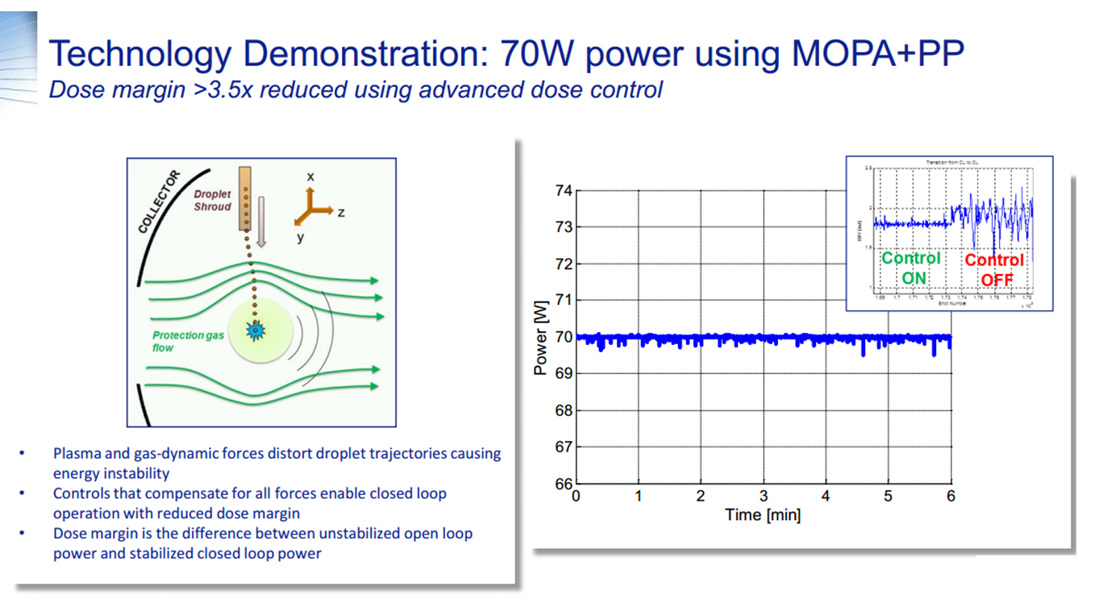
Source-LPP DPP
ASML-NXE:3300B -2014
70W MOPA-PP source power demonstrated with good
dose control

Slide 11
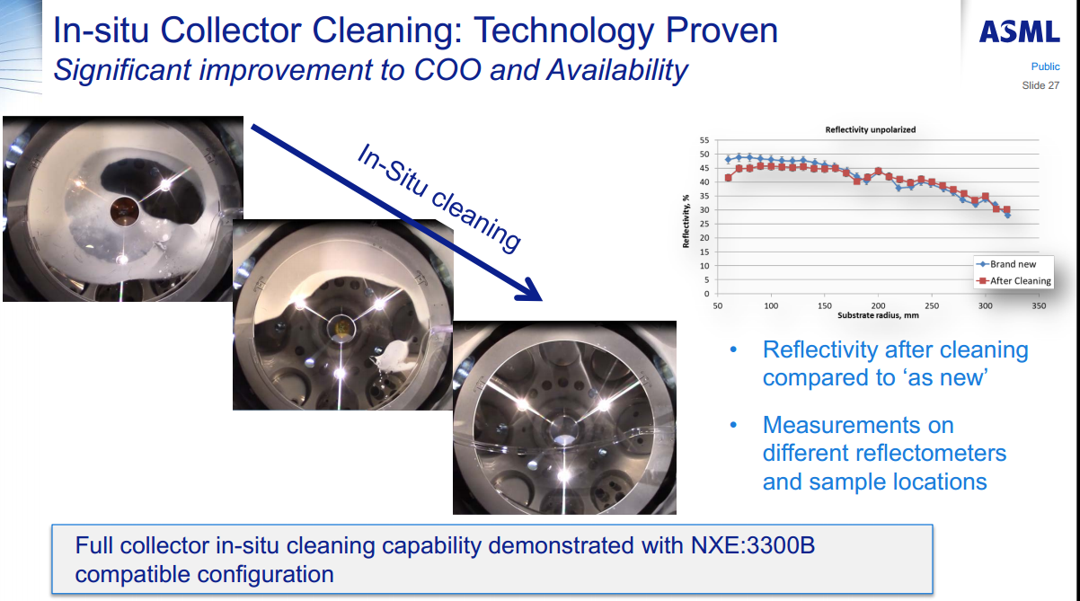
Source—LPP DPP
Notes:
debris protection, collector contamination, In-situ collector cleaning

Slide 12
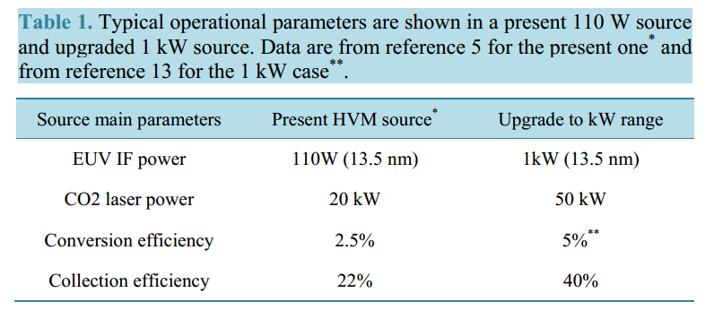
Source—LPP DPP
Journal of Modern Physics, 2014, 5, 285-295

Slide 13
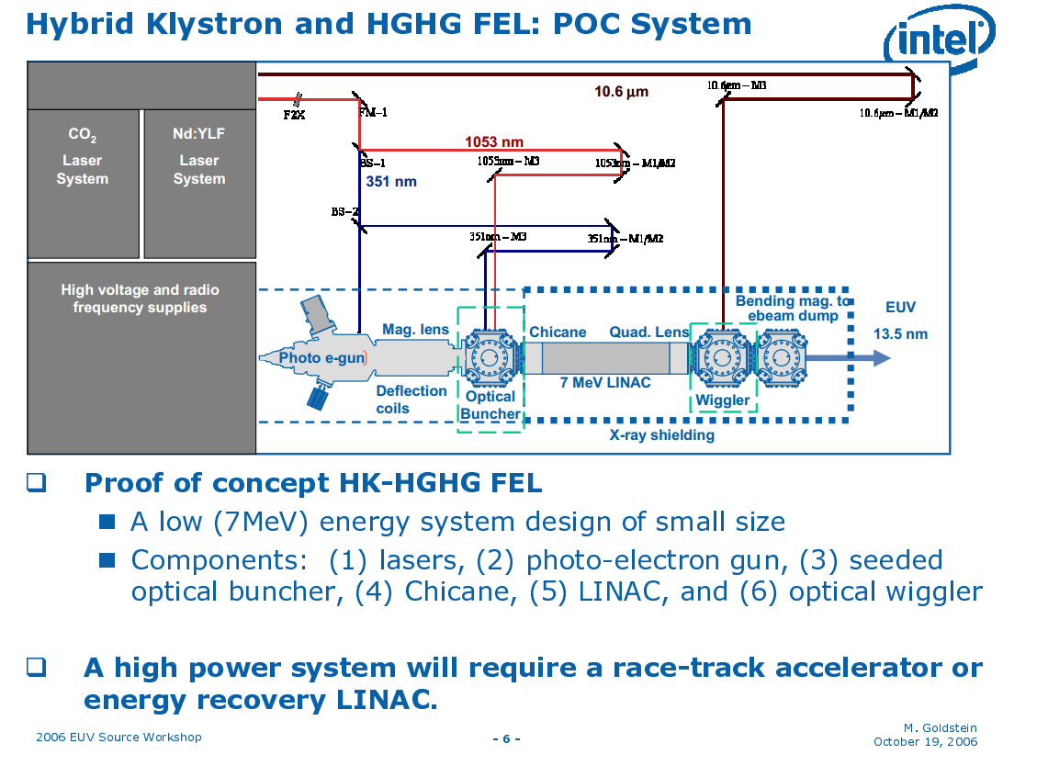
Source-FEL
Notes:
debris protection, collector contamination, In-situ collector cleaning

Slide 14
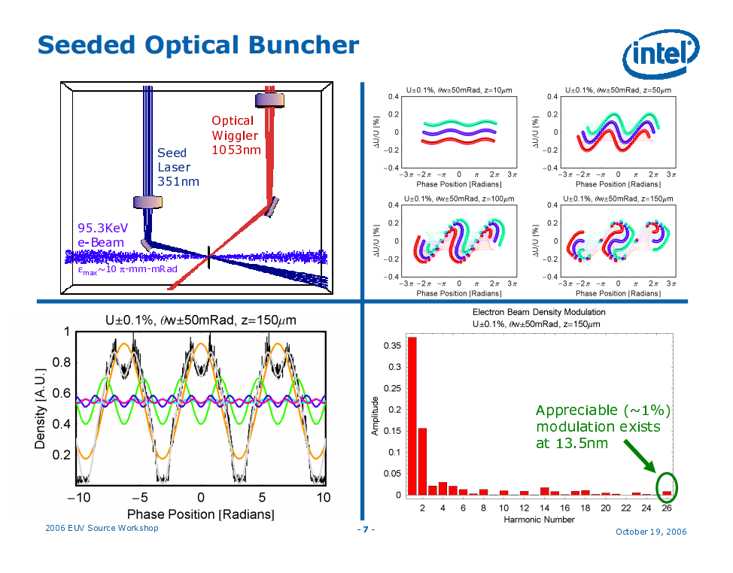
Source-FEL

Slide 15
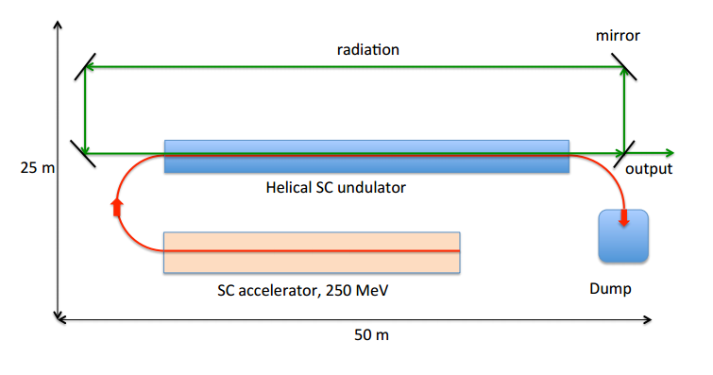
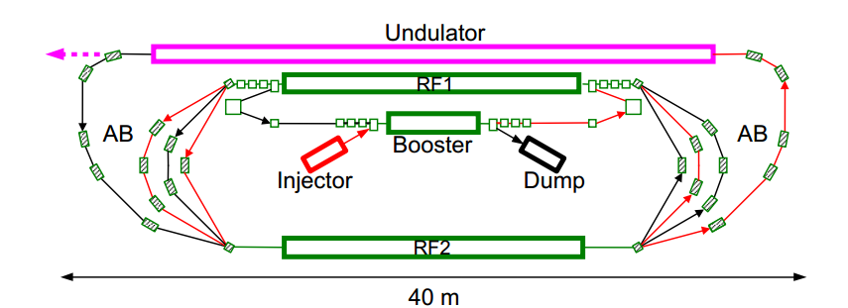
Source-FEL
FEL oscillator for EUV lithography(2014)
Multiturn ERL with FEL— SASE ~5kw
PhysRevSTAB.14.040702(2011)

Slide 16
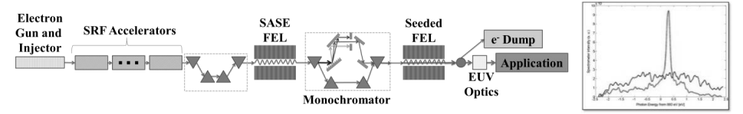
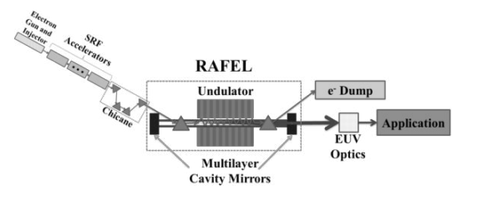
Source-FEL
Proc. of SPIE Vol. 9422 94220D-2(2015)
Schematic diagram of a FEL designed for self-seeding
Schematic diagram of a regenerative amplifier FEL (RAFEL)
Notes:
SASE, self-seeding, regenerative amplifier FEL

Slide 17
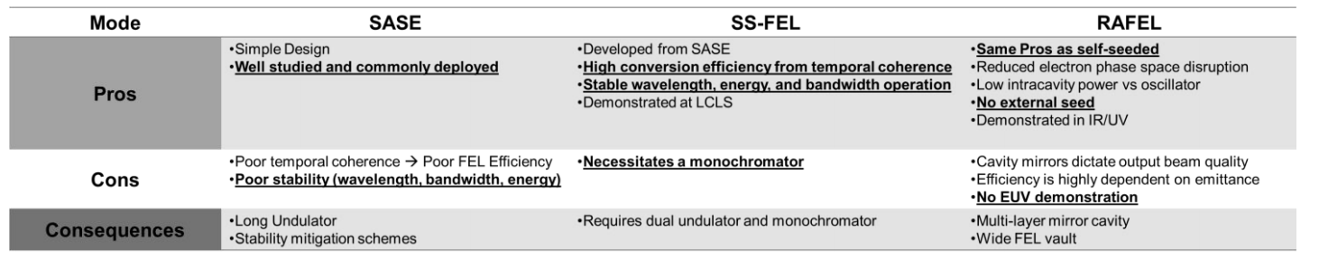
Source-FEL
Proc. of SPIE Vol. 9422 94220D-2(2015)
Comparison of presented FEL operational modes
Notes:
SASE, self-seeding, regenerative amplifier FEL

Slide 18
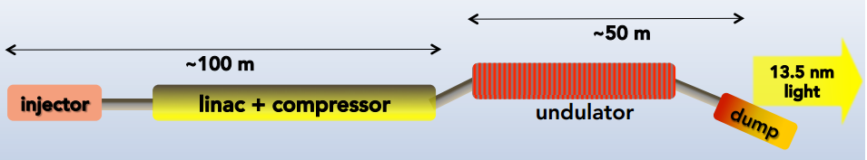
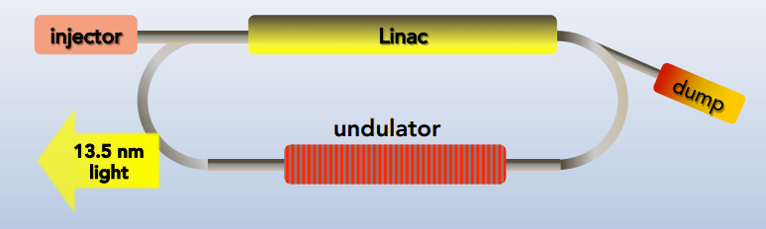
Source-FEL
Notes:
SASE, self-seeding, regenerative amplifier FEL

Slide 19
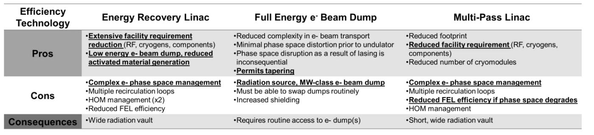
Source-FEL
Proc. of SPIE Vol. 9422 94220D-2(2015)
Comparison of energy efficiency options for FEL operation
Notes:
SASE, self-seeding, regenerative amplifier FEL

Slide 20
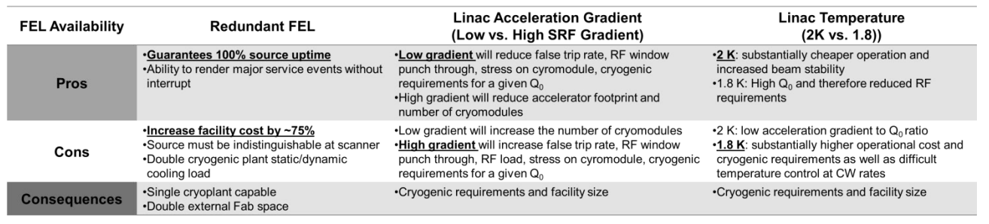
Source-FEL
Proc. of SPIE Vol. 9422 94220D-2(2015)
FEL operation efficiency options comparison relative to availability
Notes:
SASE, self-seeding, regenerative amplifier FEL

Slide 21
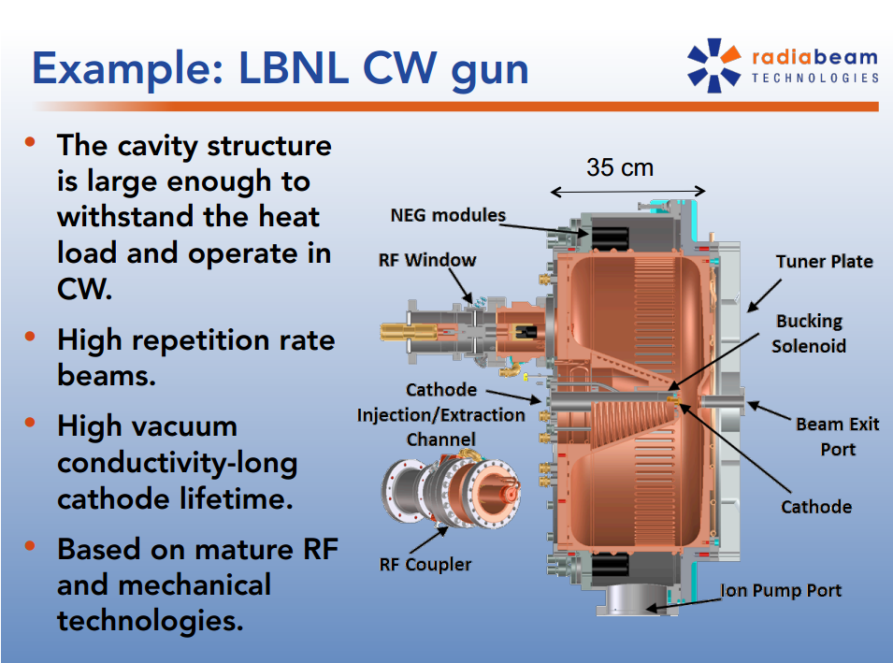
Source-FEL
2014 EUV Workshop on EUV and Soft X-ray Sources

Slide 22
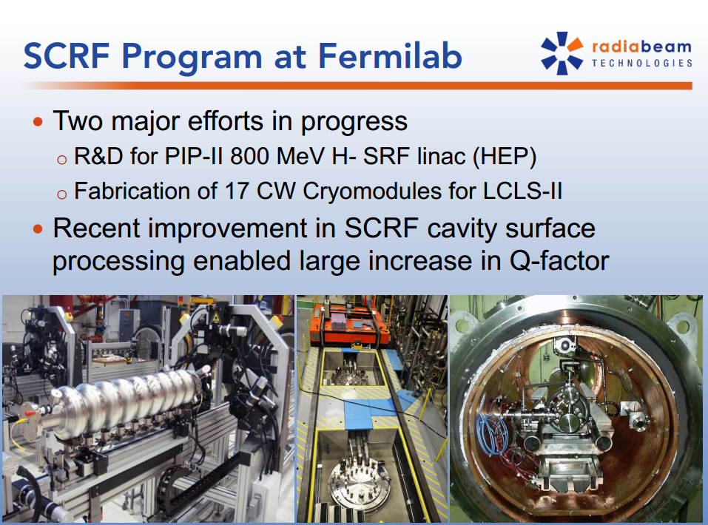
Source-FEL
2014 EUV Workshop on EUV and Soft X-ray Sources

Slide 23
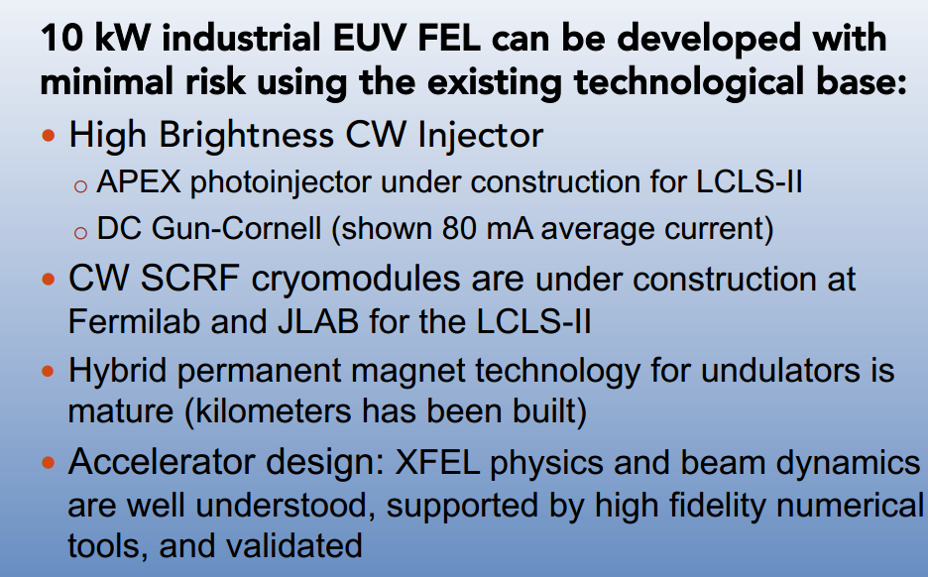
Source-FEL
2014 EUV Workshop on EUV and Soft X-ray Sources

Slide 24
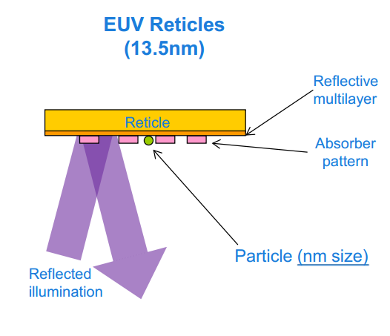
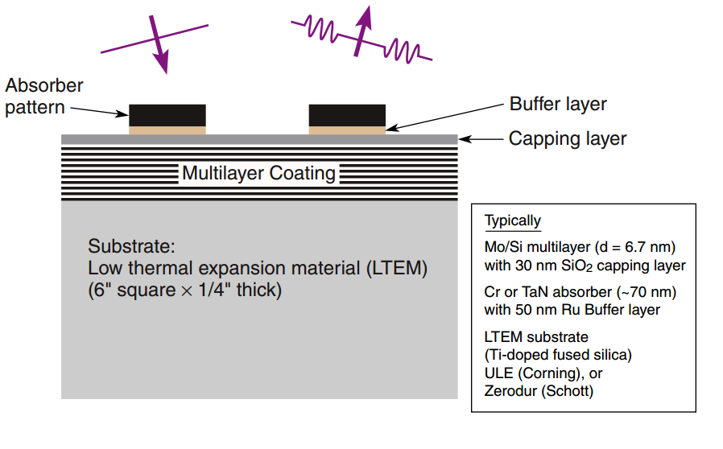
Mask

Slide 25
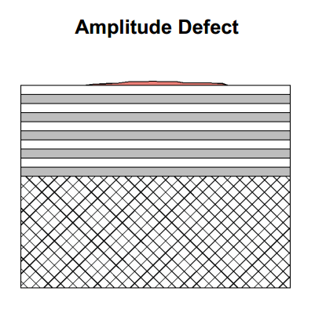
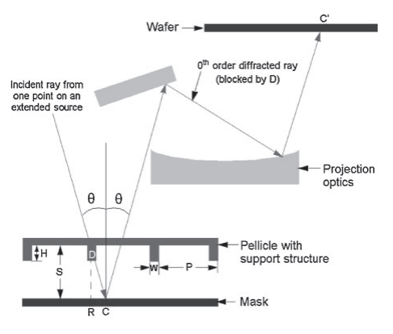
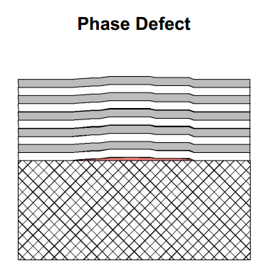
Mask

Slide 26
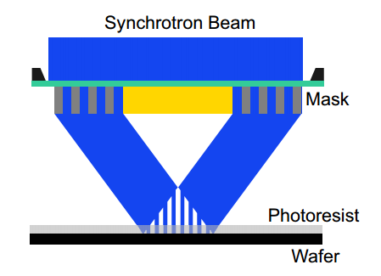
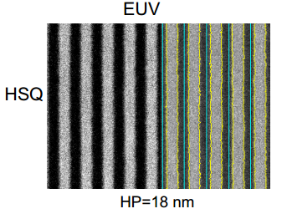
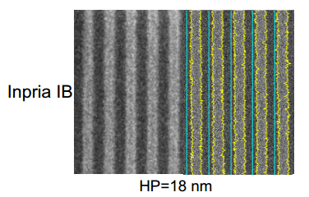
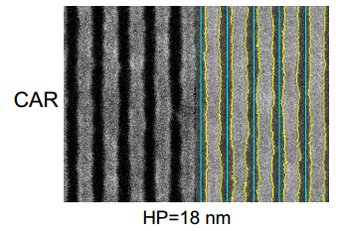
Photoresist
Resolution
Line-edge roughness
Sensitivity

Slide 27
Conclusion
FEL-Based EUV sources
Pros | Cons
High average power ~kW | Cost (Construction and Operation)
Clean (No debris) | Big footprint
Tunable | Technical complexity
 | Optics damage (high brilliance)
 | Need optimization
Optimization——SASE FEL pulse (typically 0.1mJ, 100fs, 1 mm diameter) high beam fluence (resist ablation threshold), high spatial coherence (speckle and interference patterns), random longitudinal mode spikes of high peak power micro pulses (not favourable to resist chemistry).

Slide 28
Thank you!

